Slide 1

News Identifier.
~ To prevent the rumor & finding out the truth.

Slide 2

Introduction :
~ This is a platform to justify the fake news and helps people to get the authentic one from different sources and avoid dilemmas between the real and fake.

Slide 3
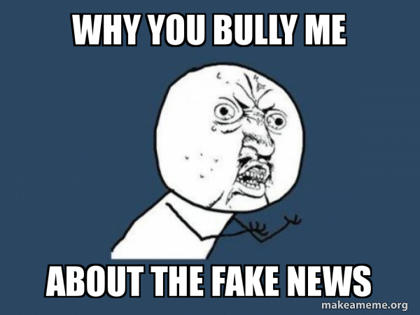

Reasons :
Fake news leaks in the name of hot topic.
Real news dug deep under the fake.
General people become frightened.
Victims get mistreated.

Slide 4


Our Targets :
It will verify the news.
Judge the authenticity.
Publish the real one.

Slide 5

Our Work lines :
We will collaborate with other platforms like BD FactCheck.
Collaboration with local news reporters & police stations.
It will also collaborate with other sites like FotoForensic, DomainData etc.
Emergency help line.
Give news combining with all the sources.

Slide 6

Why Us?
Combining all the sources in a single frame.
People don’t need to look for each segment.
Give people the most trustable news.
People can also request for one.

Slide 7

Our Business Criteria :
It will verify the news under certain subscription fees.
We will give the local news reporters 30%of subscription fees for each news.

Slide 8

The soul purpose of this site is to bring justice and prevail the truth among the people. There are people who are spreading wrong news and blind folding many people from the truth. But our platform will help this people by reaching out, seeking the truth and spreading it.

Slide 9


Slide 10


